Slide 1
Predicting Player Performance for Daily Fantasy Sports
NBA on DraftKings
J. Chen, P. Wang, R. Ho

Slide 2
Agenda
What is Fantasy Sports?
Traditional vs DFS
Draft Kings
Rules and User Statistics
EDA
Modeling and Predictions
Features, XGBoost, Bayesian Optimization, Time Series, Stacking
Knapsack Problem
Greedy Algorithm, Genetic Algorithm
Results
Future Improvements

Slide 3
What is Fantasy Sports?
Traditional Fantasy
Friends form a league and draft players to create their own fantasy teams
Compete H2H on a weekly basis to the entire season using the drafted teams
Players are allowed to trade and sign free agents throughout the season
Players with the best W-L record at the end of the season win
Daily Fantasy Sports
Players join pools and draft a team for the day
Given a predetermined budget, construct a team that will outperform the rest of the pool
Players in the top percentile of the pool win

Slide 4
NBA on DraftKings: Fantasy Points
SCORING RULES
Players will accumulate points as follows:
Point = +1 PT
Made 3pt. shot = +0.5 PTs
Rebound = +1.25 PTs
Assist = +1.5 PTs
Steal = +2 PTs
Block = +2 PTs
Turnover = -0.5 PTs
Double-Double = +1.5PTs (MAX 1 PER PLAYER: Points, Rebounds, Assists, Blocks, Steals)
Triple-Double = +3PTs (MAX 1 PER PLAYER: Points, Rebounds, Assists, Blocks, Steals)

Slide 5
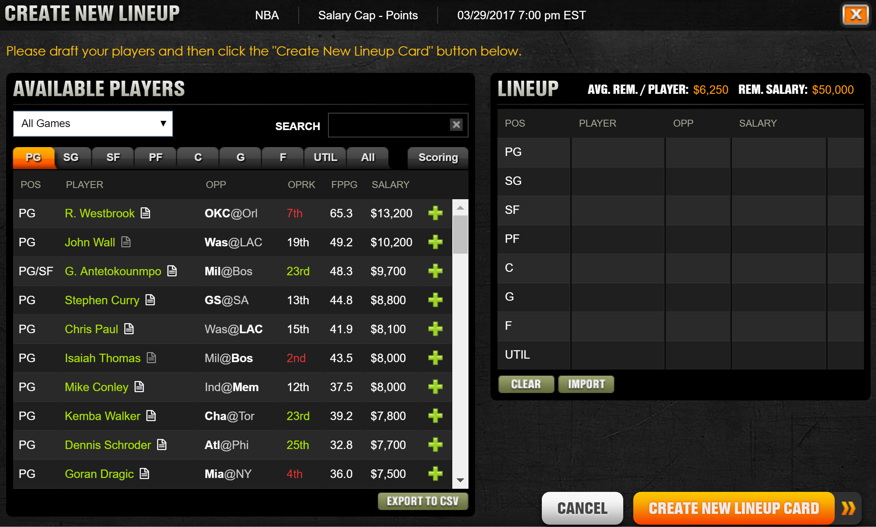
NBA on DraftKings: Constraints
ROSTER REQUIREMENTS
Rosters will consist of 8 players and must include players from at least 2 different NBA teams, and representing at least 2 different real-life NBA games.
The 8 roster positions are: PG, SG, SF, PF, C, G, F, and UTIL.
SALARY RULES
In each contest, participants will create a lineup by selecting players listed in the Player Pool. Each player listed has an assigned salary and a valid lineup must not exceed the salary cap of $50,000.

Slide 6
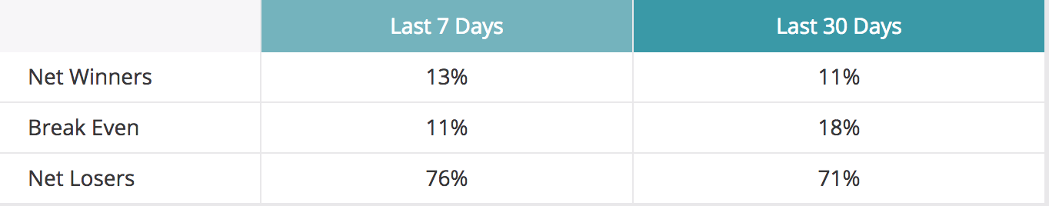
DraftKings: User Statistics
https://www.draftkings.com/average-results

Slide 7
Types of Games / Strategy
GPP (Tournament)
Payout scales with position on scoreboard (up to 35x entry for 1st place)
Cut off at ~20% (2x payout for last eligible winner)
Double-Up
Payout is always 2x the cost of entry
Cut off is ~42%
Multiplier
Payout is 3x, 4x, 5x, etc...
Cut off is a ratio to the multiplier (10x requires placement within ~8% or top 3/34)
H2H / 50/50
Payout is ~1.8x
Cut off is top 50%

Slide 8
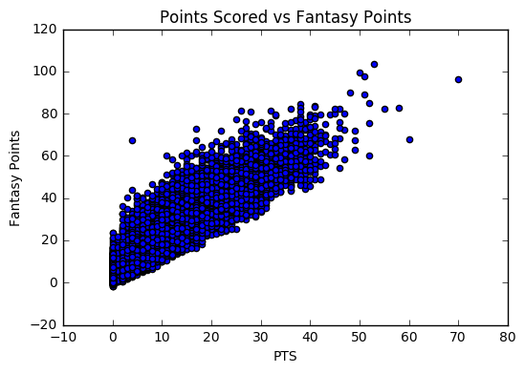
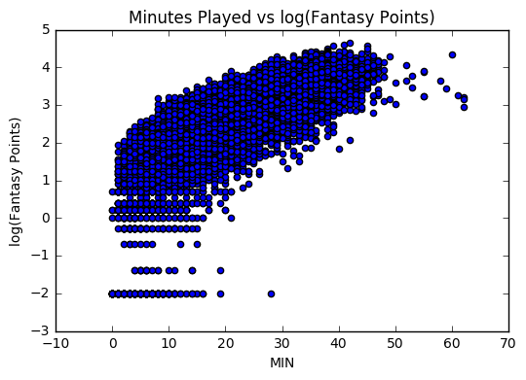
Basic EDA: Real Time Stats to Fantasy Points

Slide 9
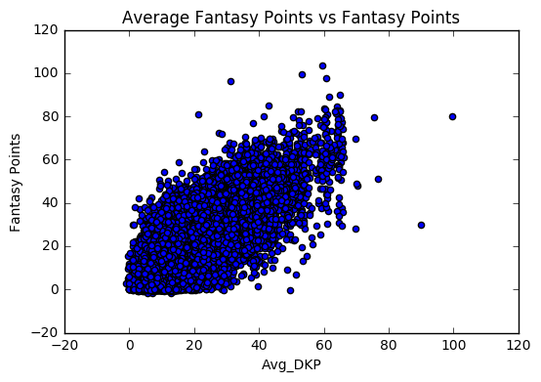
Feature Engineering
Cannot use real time stats
Need to create features based on past games
Incorporate team and opponent stats

Slide 10
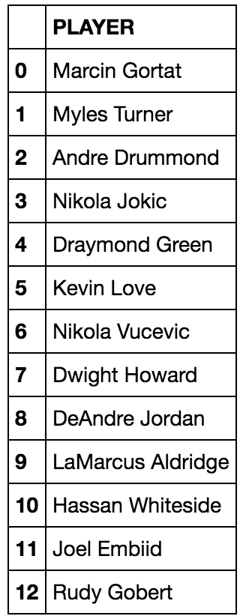
Grouping Players: K-means
Not enough data points in a single season for a specific player to create models for each player
Clustered similar players together based on their season averages

Slide 11
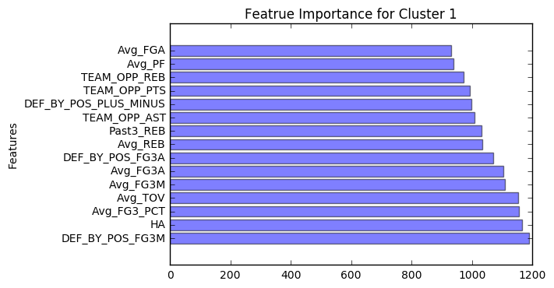
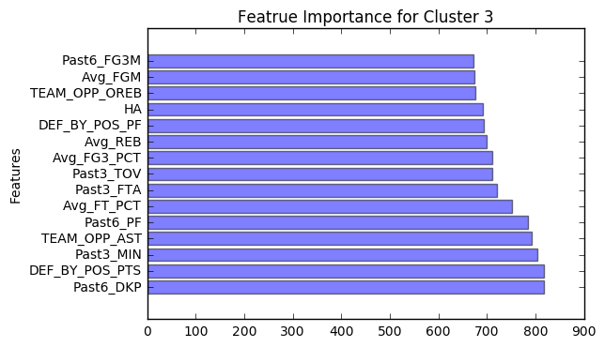
Prediction Model: XGBoost

Slide 12
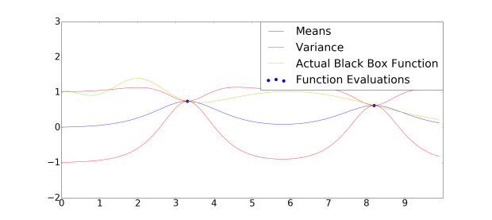
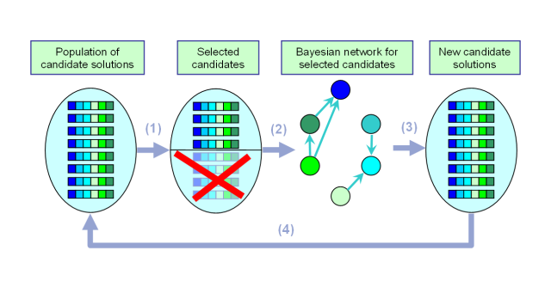
Model Tuning
Bayesian Optimization

Slide 13
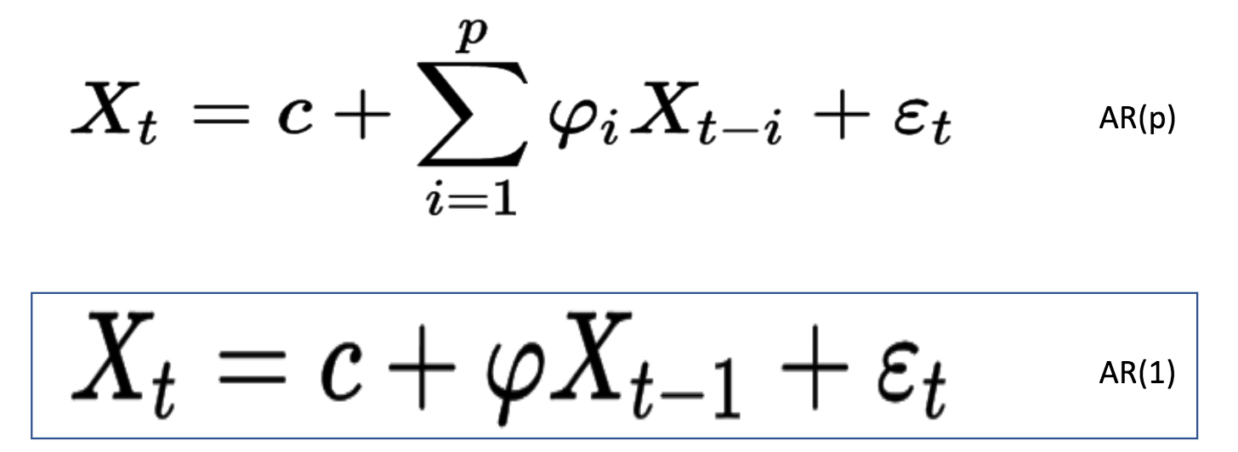
Time Series Model 1: Simple AR(1) Model
We chose AR(1) to keep the model simple (Too little observations so mo
We chose AR(1) to keep the model simple (Too little observations so more complicated models won’t do as well)
Most players have about 20-30 observations
X_t = DKP_t (Draft King Points at time t)

Slide 14
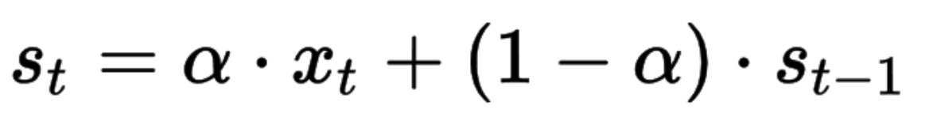
Time Series Model 2: Exponentially Weighted MA
X_t = DKP at time t
S_t = Forecasted value for time t
Alpha is the smoothing factor and between 0 and 1
Small alpha => More smoothing effect => Less responsive to recent changes
Large alpha => Less smoothing => More responsive
We chose alpha = 0.95

Slide 15
Player Volatility
Player’s minutes can vary greatly depending on the injury or playing status of their teammates
Scale their score to according to the minutes we believe they will get when a teammate sits out
Scale their score if they are coming back from a long injury
Scale their score based on a weight related to the overall volatility of their performance

Slide 16
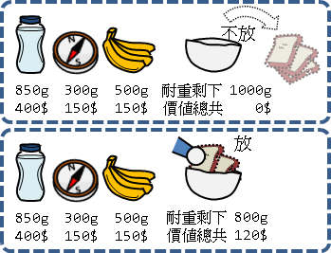
Knapsack Problem: Selecting a Lineup

Slide 17
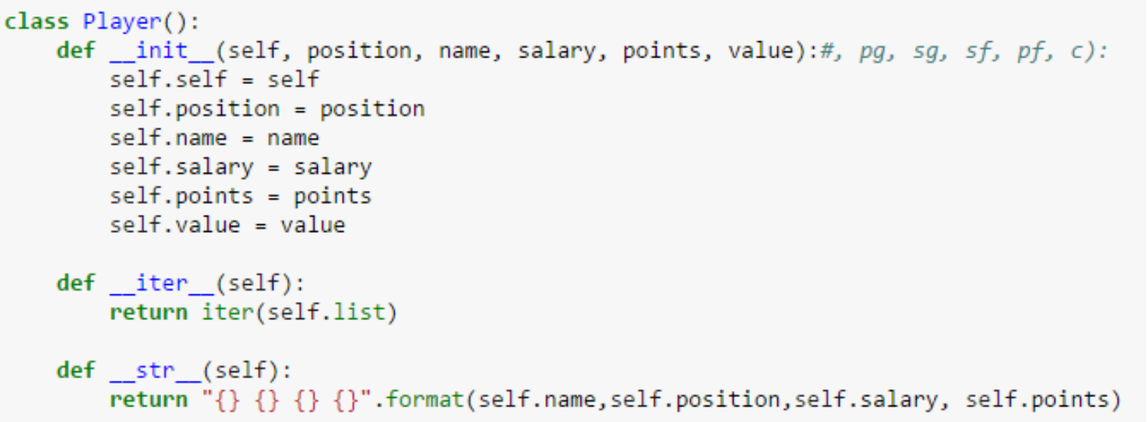
Greedy Algorithm
Define a class of players
Set the limit of positions and of budget
Limit not reached => Include the available player with the largest points
Points here are the estimated points using two TS models
Second model (EWMA) performed slightly better for recent games

Slide 18
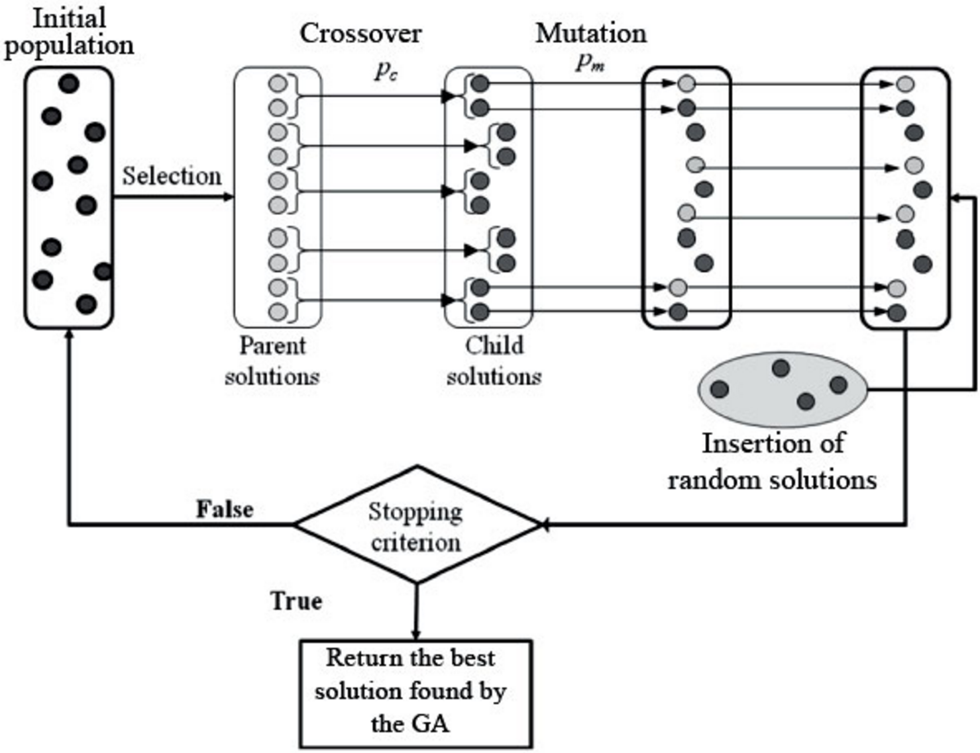
Genetic Algorithm

Slide 19
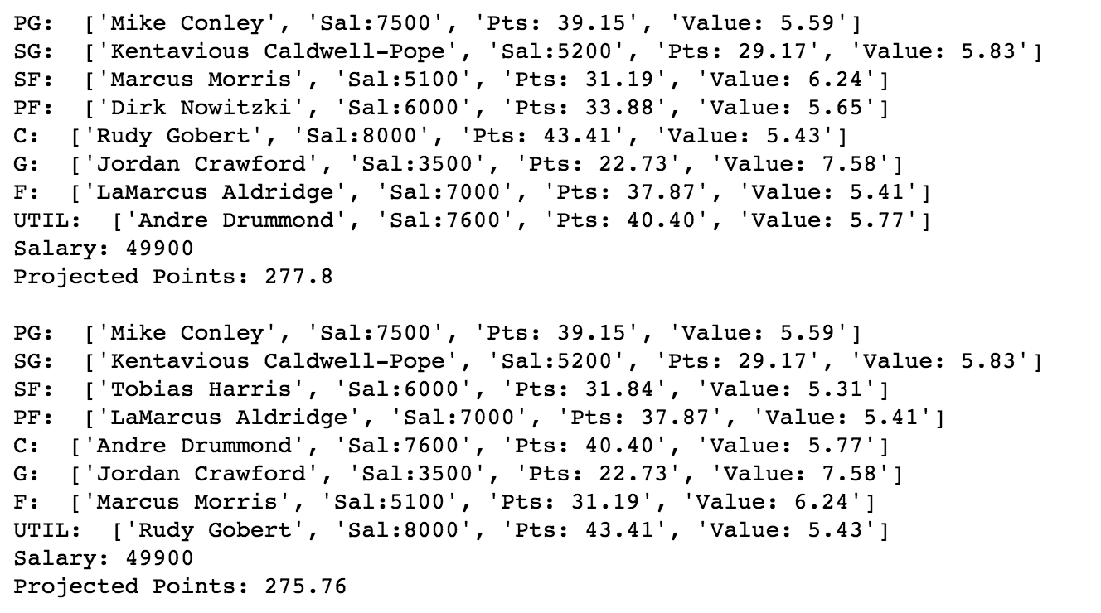
Knapsack Problem: Selecting a Lineup
Example Lineups:

Slide 20
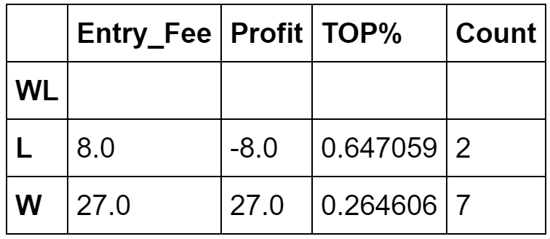
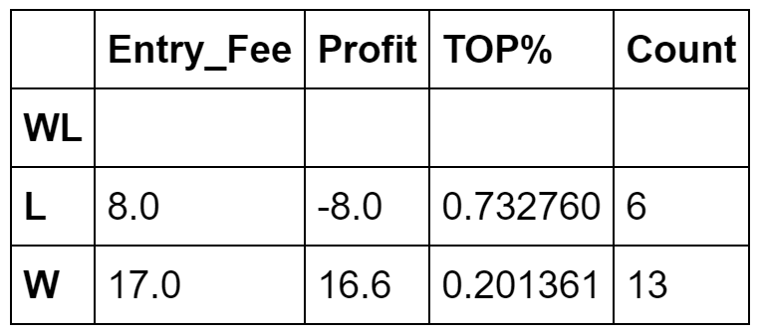
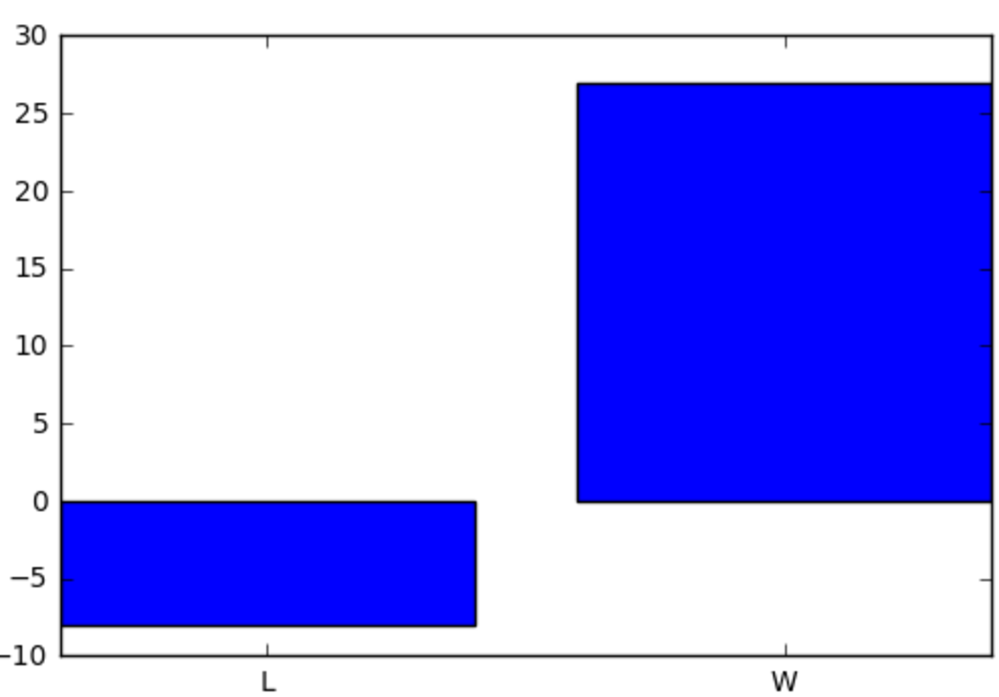
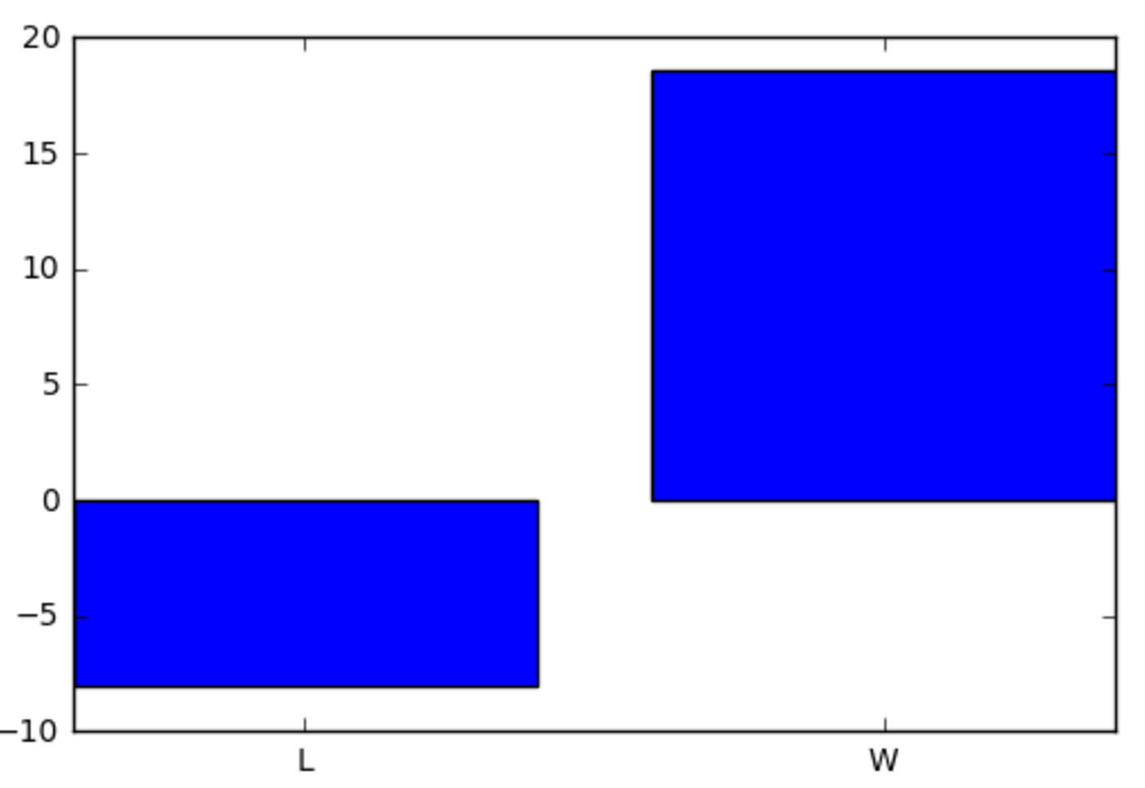
Records
$27.00
$18.60
ROI:
54.28%
ROI: 34.4%
-$8.00
-$8.00

Slide 21
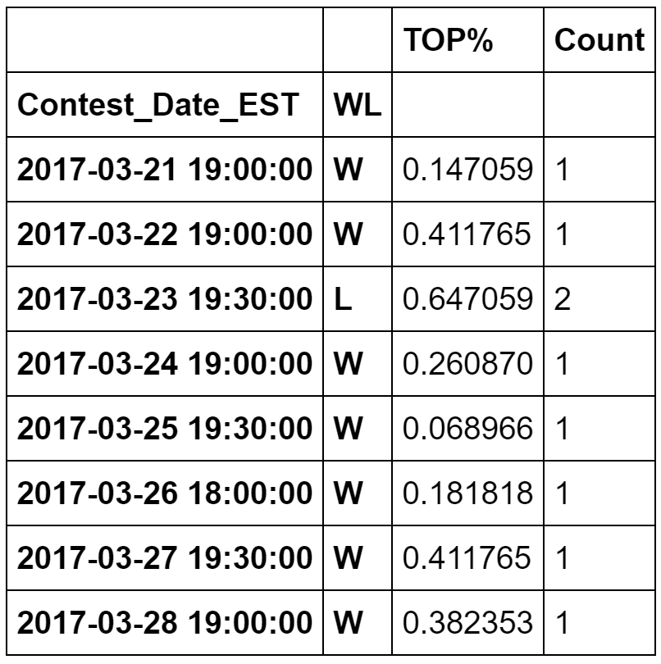
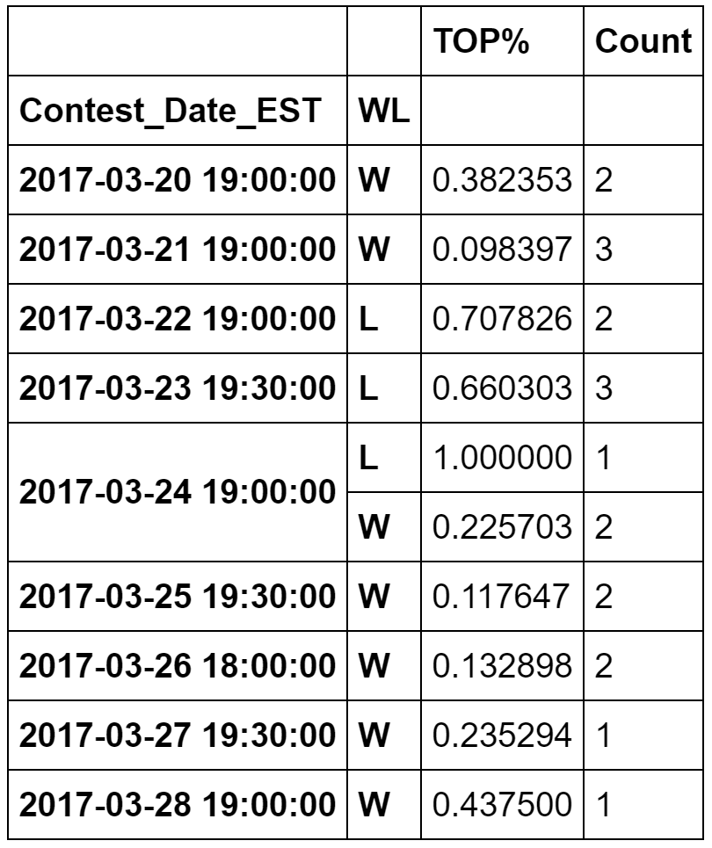
Records

Slide 22
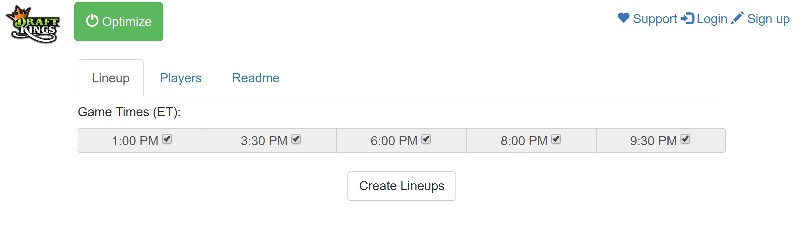
Web App: Good Enough
Live Demo
[Place Pic Here]

Slide 23
Future Work
Make predictions applicable to other daily fantasy games
NFL, NHL, MLB, GOLF, ETC...
Advanced Features
Incorporate and create more advanced stats
Include features not directly related to the game (player and team news)
Incorporate more models
Collaborative filtering?
Testing and Tuning
Improve web app
Make front end design more aesthetically pleasing
Have the data automatically update daily on a server

